Slide 1



Miranda Insights LLC
March 2026
Student Performance
& Attendance Analysis
A data-driven exploration of student performance and attendance patterns to uncover actionable educational insights.
Presentor
Kyle Miranda
Click here to proceed

Slide 2

Miranda Insights LLC
March 2026
Problem Statement
This analysis examines how student subgroups differ in academic performance and attendance to identify potential equity gaps and improvement opportunities.
The Objective
Key Questions
Why it Matters
This project analyzes student performance and attendance data to identify patterns in academic outcomes across key student subgroups, including English Learners, Special Education students, grade levels, and schools.
Are certain student groups underperforming?
How does attendance impact academic performance?
Which schools or grades show the most variability?
Understanding these trends helps educators and stakeholders make informed decisions to improve student outcomes, allocate resources effectively, and identify at-risk populations early.

Slide 3



Miranda Insights LLC
March 2026
Data
Overview
This project uses a simulated Student Information System (SIS) dataset containing student demographics, attendance records, assessment scores, and school information. The data was structured into a relational database, allowing for efficient joins and scalable analysis across multiple dimensions such as grade level, program participation (EL/SPED), and subject performance.
The workflow integrates multiple technologies to demonstrate a full data pipeline. Data was queried and secured using SQL, extracted via a Python API pipeline, analyzed using Python and R, and visualized through both Quarto dashboards and Excel. Final insights were compiled into presentation-ready visuals and reports, showcasing both technical execution and business communication.

Slide 4
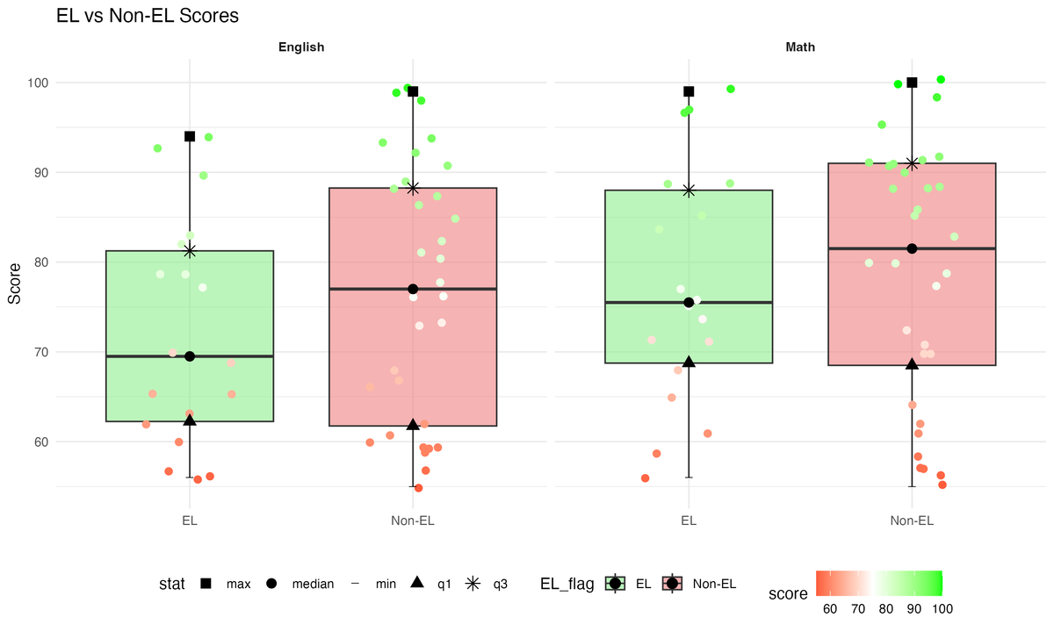
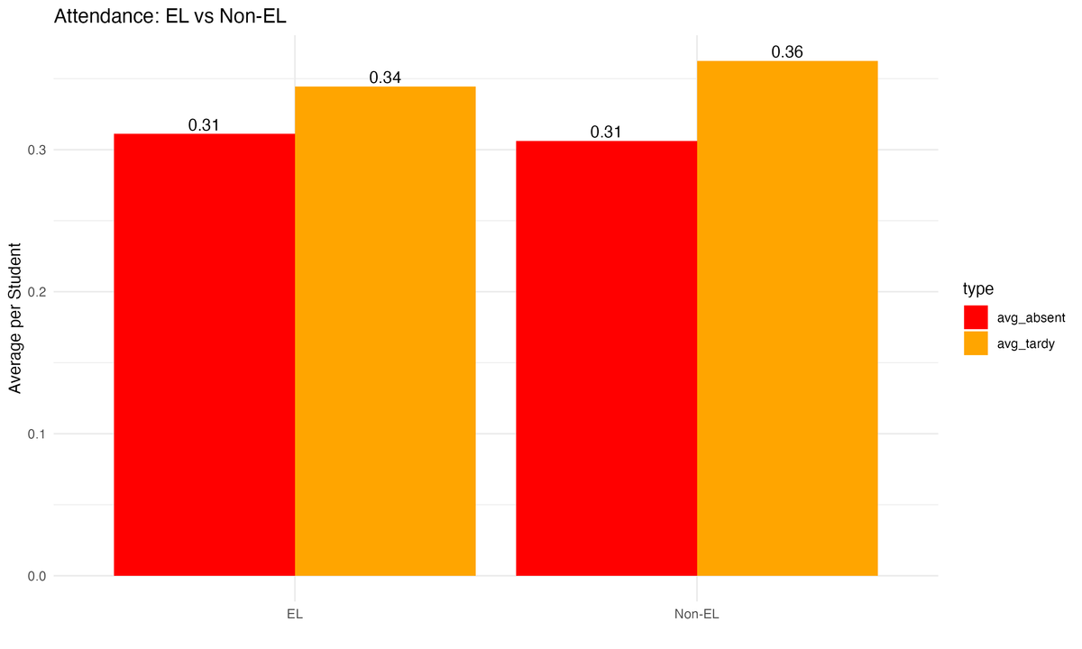
Miranda Insights LLC
March 2026
EL vs Non-EL
This view compares academic performance and attendance patterns between English Learner and non-EL student groups.

Slide 5
Miranda Insights LLC
March 2026
EL vs Non-EL
This view compares academic performance patterns between English Learner and non-EL student groups.
EL_flag | subject | n | mean | median | q1 | q3 | min | max
EL | English | 18 | 72.22 | 69.5 | 62.25 | 81.25 | 56 | 94
EL | Math | 18 | 77.39 | 75.5 | 68.75 | 88 | 56 | 99
Non-EL | English | 32 | 76.62 | 77 | 61.75 | 88.25 | 55 | 99
Non-EL | Math | 32 | 78.94 | 81.5 | 68.5 | 91 | 55 | 100

Slide 6
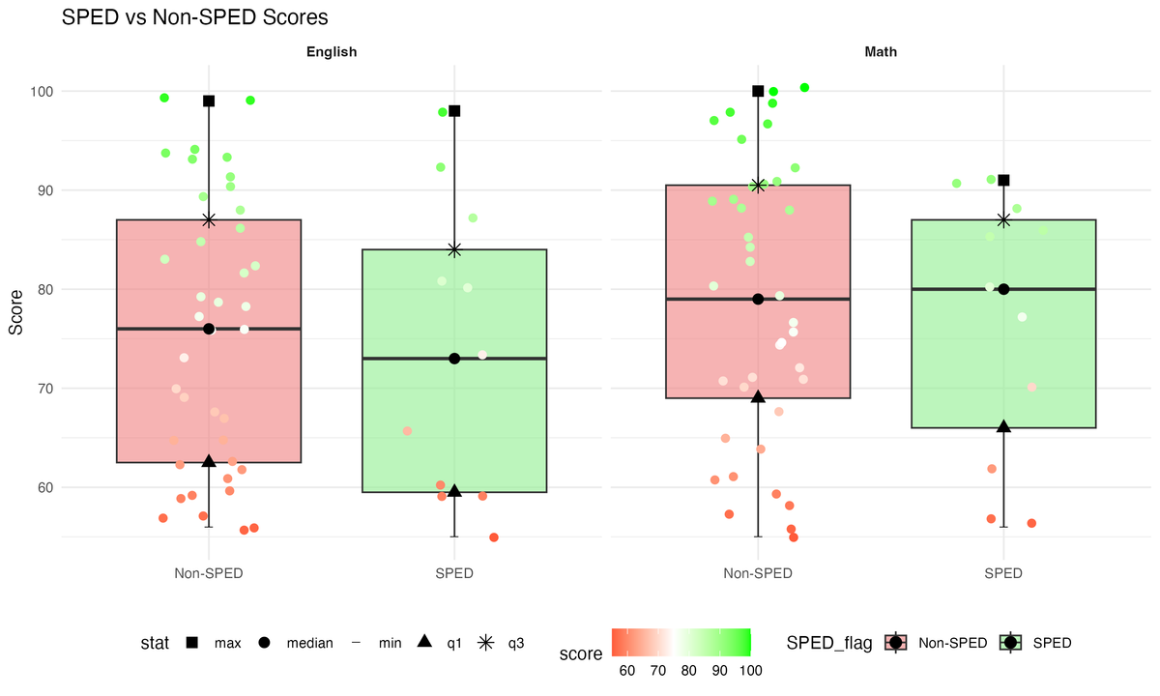
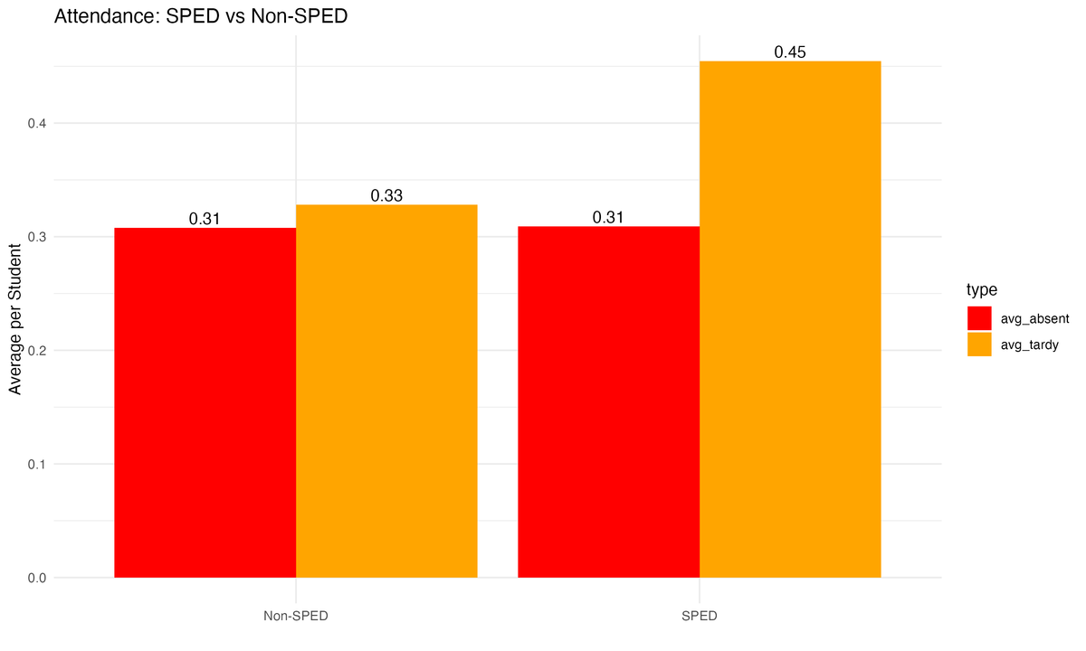
Miranda Insights LLC
March 2026
SPED vs Non-Sped
This view compares academic performance and attendance patterns between English Learner and non-EL student groups.

Slide 7
Miranda Insights LLC
March 2026
SPED vs Non-Sped
This view compares academic performance patterns between English Learner and non-EL student groups.
sped_flag | subject | n | mean | median | q1 | q3 | min | max
Non | English | 39 | 75.44 | 76 | 62.5 | 87 | 56 | 99
Non | Math | 39 | 78.87 | 79 | 69 | 90.5 | 55 | 100
SPED | English | 11 | 73.64 | 73 | 59.5 | 84 | 55 | 98
SPED | Math | 11 | 76.64 | 80 | 66 | 87 | 56 | 91

Slide 8
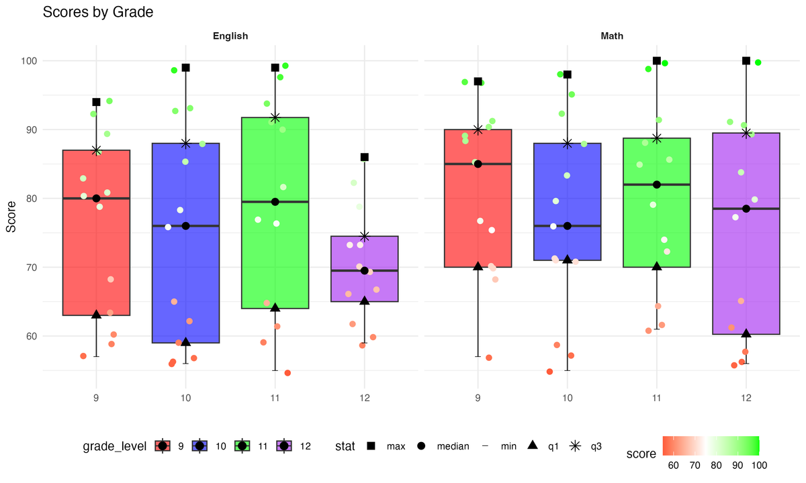
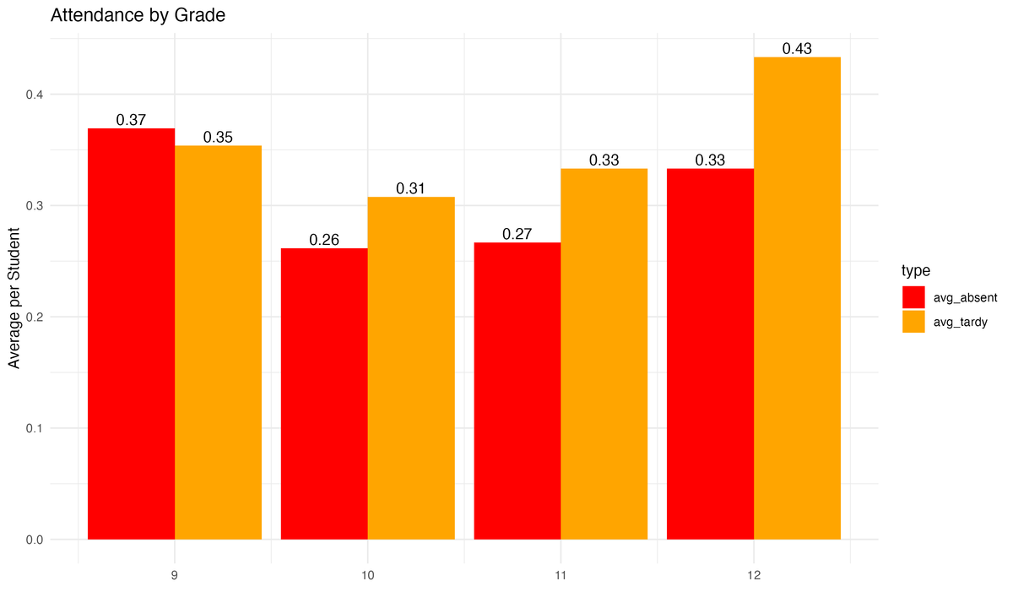
Miranda Insights LLC
March 2026
Grade Comparison
This view compares academic performance and attendance patterns between English Learner and non-EL student groups.

Slide 9
Miranda Insights LLC
March 2026
Grade Comparison
This view compares academic performance between English Learner and non-EL student groups.
grade | subject | n | mean | median | q1 | q3 | min | max
9 | English | 13 | 76.31 | 80 | 63 | 87 | 57 | 94
9 | Math | 13 | 81.08 | 85 | 70 | 90 | 57 | 97
10 | English | 13 | 74.38 | 76 | 59 | 88 | 56 | 99
10 | Math | 13 | 76.62 | 76 | 71 | 88 | 55 | 98
grade | subject | n | mean | median | q1 | q3 | min | max
11 | English | 12 | 78.92 | 79.5 | 64 | 91.75 | 55 | 99
11 | Math | 12 | 80.08 | 82 | 70 | 88.75 | 61 | 100
12 | English | 12 | 70.5 | 69.5 | 65 | 74.5 | 59 | 86
12 | Math | 12 | 75.67 | 78.5 | 60.25 | 89.5 | 56 | 100

Slide 10
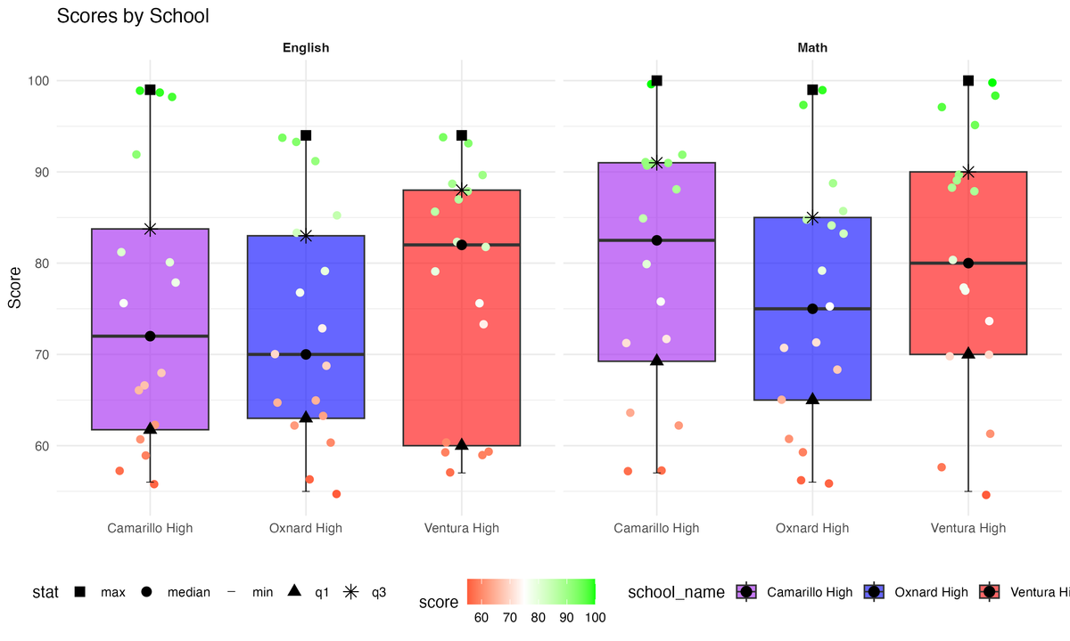
Miranda Insights LLC
March 2026
School Comparison
This view compares academic performance and attendance patterns between English Learner and non-EL student groups.

Slide 11
Miranda Insights LLC
March 2026
School Comparison
This view compares academic performance patterns between English Learner and non-EL student groups.
school | subject | n | mean | median | q1 | q3 | min | max
ACHS | English | 16 | 74.94 | 72 | 61.75 | 83.75 | 56 | 99
OHS | English | 17 | 72.94 | 70 | 63 | 83 | 55 | 94
VHS | English | 17 | 77.24 | 82 | 60 | 88 | 57 | 94
school | subject | n | mean | median | q1 | q3 | min | max
ACHS | Math | 16 | 79.25 | 82.5 | 69.25 | 91 | 57 | 100
OHS | Math | 17 | 75.53 | 75 | 65 | 85 | 56 | 99
VHS | Math | 17 | 80.41 | 80 | 70 | 90 | 55 | 100

Slide 12








Miranda Insights LLC
March 2026
Technical Stack
Supabase & SQL
Quarto & R
Data Infrastructure
Visualization & Reporting
Designed and managed a relational database using SQL, including schema creation, data validation, and row-level security policies for controlled access.
Developed publication-quality visualizations and a fully self-contained HTML dashboard using R and Quarto, enabling professional and shareable reporting.
VS & Python
Excel & Github
Data Engineering & Analysis
Business Tools & Delivery
Built a Python-based pipeline to extract data from Supabase APIs, transform datasets, and prepare them for analysis and export across multiple platforms.
Delivered insights through Excel dashboards with pivot tables and KPIs, while maintaining version control and project transparency via GitHub.
“End-to-End Data Pipeline: From Raw Data to Decision-Ready Insights”

